Slide 1
Utilizing Forecasts to Assist in 2022 Goal Setting
Last Updated: 2022.02.07

Slide 2
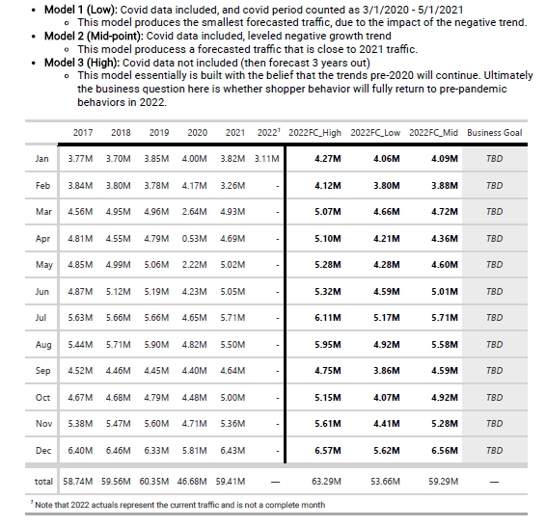
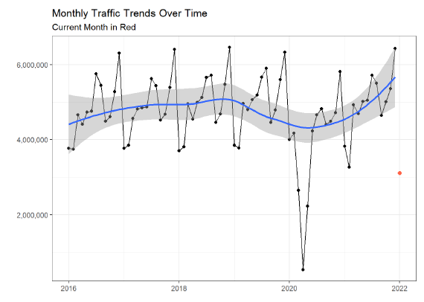
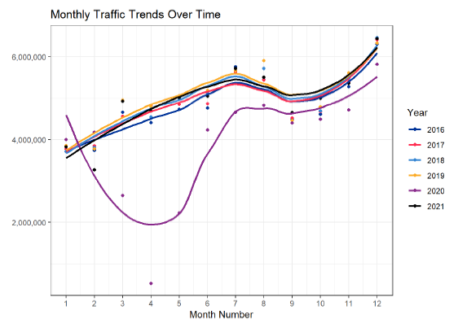
Purpose
Process
To present “reasonable” baselines for the Commercial leaders to set 2022 goals.
Forecast: setting baseline of potential future values independent of new strategies implement by the business.
Extracted historical data for metrics
Visualized historical trends
Developed multiple forecasting models
Adjust for Covid (3/1/2020 – 5/1/2021
Adjust & Flatten trends
Remove 2020/2021 (Business returns to pre-pandemic)

Slide 3
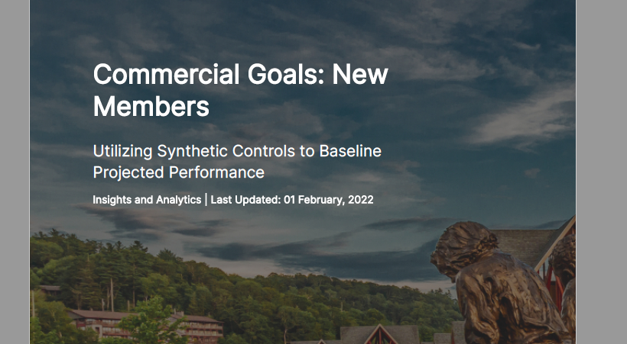
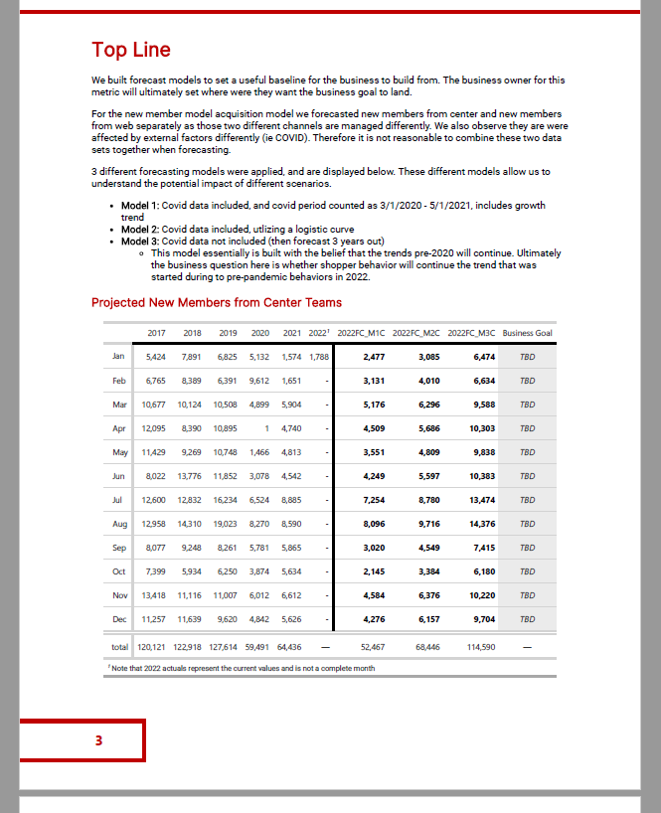
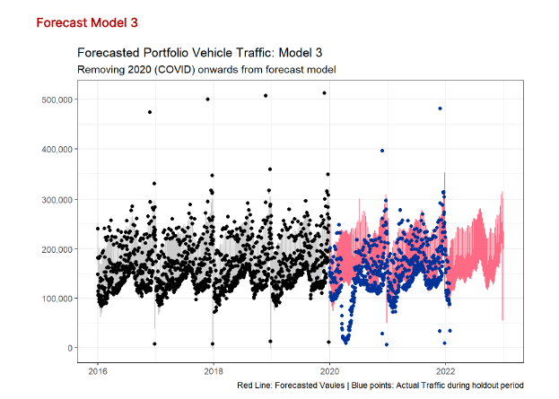
Outcomes
Forecasted multiple scenarios and produced a document for the business for each of the following metrics:
Retailer Revenue, Vehicle Traffic, Digital Traffic, wifi Utilization, New Members
Produce seasonal trend visuals:
Unique members with receipts by year

